Slide 1
Globalisation and Women
By Betsy Francis Mearns

Slide 2
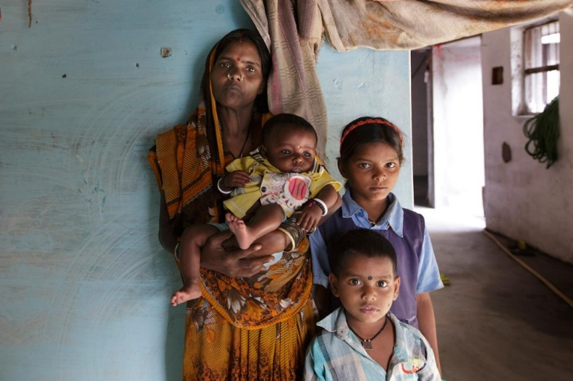
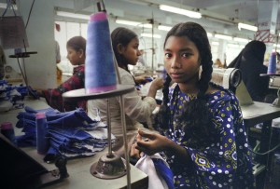
Women in Work
Since globalisation has began taking place, many high-profile men's jobs have been deskilled which means young women can take on jobs, in a bank for example, which requires them to do repetitive simple tasks for a low wage. This is called proletarianisation, in which a once high paid job is changed to be a low wage, simple job that is often not secure.
If a developing country takes out a loan with the IMF or World Bank then hits an economic crisis, these corporations may force the country to create fees for education and healthcare in order to pay back the debt. This penalises women the most as women are forced to care for the sick and elderly, this means they are taking on a triple burden of caring for others, working for her own wage and still doing domestic chores. Also, if there are fees in education a family will tend to favour their sons education over their daughter which means they will not be able to escape the cycle of poverty.
An EPZ (Export Processing Zone) is an area within a developing country which offers tax incentives and a barrier-free environment in order to gain more wealth for the country. In Latin America and The Philippines, companies in these EPZ would make women take a pregnancy test when hired ‘because pregnant women were too costly to the company’ (-a doctor working for an MNC in a maquiladora (Mexican EPZ)). The doctor got so angry that the company was exploiting young girls that he told the supervisors that girls weren’t pregnant when they were. This double standard is prevalent throughout Western Society too as women may be seen as a less desirable candidate because of the ‘risk’ of them getting pregnant. Men are not subject to this as they are not seen as a ‘risk candidate’

Slide 3
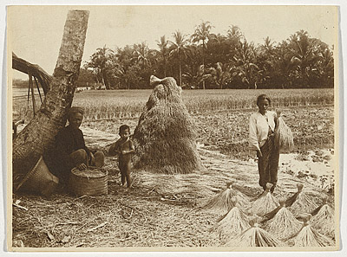
Women in the Home
Globalisation has meant women can now earn enough money doing labour outside the home that they can reduce the amount of labour they do in the home. With technological advances, household products such as a cooker, washing machine and hoover have been invented and become cheap enough for many households to be able to afford. Cookers, hoovers and dishwashers all help free up a women's time so they can have more time for work, childcare or leisure time.
Being a mother is a struggle for any woman but when you are below the poverty line the choice of having to decide whether to stay with your baby or go out to work to feed it is a hard task. Women in developing countries experience this more than anyone else. Jennifer, a single mother living in Kenya who works on the plantations, stayed at home for only four weeks after her child was born in order to continue earning a wage to provide for her child. She couldn’t take her child on the plantation as her employer, like many others, had prohibited it. When, in the past before health and safety regulations were brought in, Jennifer could spend the crucial first months of her child's life with her child .

Slide 4
Feminism and Globalisation
With globalisation and the internet, women's issues are brought to the table more regularly, online petitions mean change can take place with enough support from people all over the world. If a petition reaches enough signatures then the issue can be brought up in parliament and gives politicians a chance to discuss the problem before deciding if anything can or should be done.
Social media is used slightly more by women, with 70% of users of Pinterest and Instagram being women but only 13% of Wikipedia contributions are by women (NY Times 2011). This shows that the more academically knowledgeable online sites are dominated by male views and knowledge, whereas the more creative and leisurely apps are dominated by females. This may be because women are more encouraged to follow their ‘creative’ dreams whereas men are pushed towards highly skilled positions.
Haraway (1991) wrote a book called ‘Simians, Cyborgs and Women: The Reinvention of Women’, she suggests that with greater knowledge of cyborgs (part human-part machine) we could allow people to rise above the gender-bound ideas we have as a person. She explains that with this knowledge we could overcome problems with feminism and capitalism.

Slide 5
Postmodernism
Postmodernists argue that most feminist theory and Functionalist theory is out of date as society has significantly increased women’s opportunities. Flaw in this is that it tends to be linked to income and wealth and that women on lower incomes are still trapped in more traditional formal and informal roles.
Postmodernists believe that globalisation and society in general has increased women's opportunities as they have a lot more freedom. They argue that feminist and functionalist theories are out of date since human advancement has taken place very fast over the last century.
Postmodern theory can be critiqued because although women have more freedom to work they can still be trapped in low income jobs. A study was carried out by ‘The Work Foundation’ which showed that between 1993 and 2011 the share of female 16-24 year-olds in employment doing low-paid work has increased from seven per cent to 21 per cent. This shows that there are more jobs available for women but there is still horizontal segregation where women dominate low skilled, low paid and often part time job positions.
Women, especially mothers, tend to go for lower skilled, flexible jobs because it means they have more time to spend looking after their family, especially when there is a father around too. This means they are usually in positions where they cannot climb the career ladder while they watch men glide up on a glass elevator.

